Slide 1
Pooled Analysis of STEP-HFpEF and STEP-HFpEF DM randomized trials
&
Findings from the STEP-HFpEF Programme Across the Age Spectrum
This presentation was developed by Novo Nordisk Inc.
Butler, Javed et al. Lancet (London, England) vol. 403,10437 (2024): 1635-1648. doi:10.1016/S0140-6736(24)00469-0
Eur J Heart Fail. 2025 Nov 25;27(11):2537–2543. doi: 10.1002/ejhf.70049

Slide 2
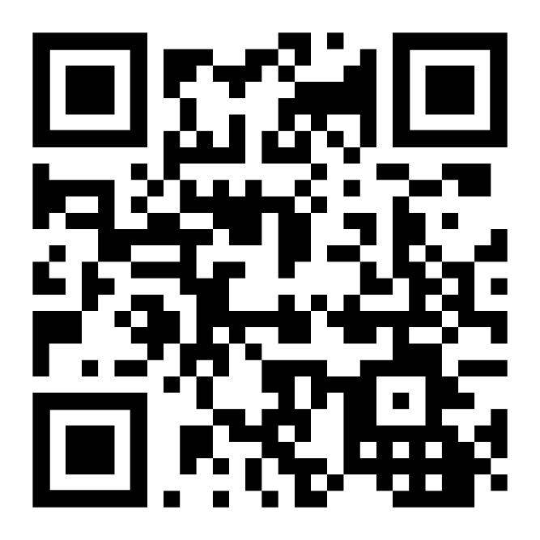
This presentation was developed by Novo Nordisk Inc.
Access the approved PI
Click the URL
https://www.novo-pi.com/wegovy.pdf
OR
Scan the QR code
Semaglutide
2.4 mg once-weekly:
approved indications
PI, prescribing information; OW, once-weekly; QR, quick response; URL, uniform resource locator.

Slide 3
Semaglutide 2.4 mg has not been approved by the FDA for treatment of obesity-related heart failure with preserved ejection fraction (HFpEF) in people with or without type 2 diabetes, and the safety and effectiveness of semaglutide 2.4 mg for the treatment of HFpEF has not been established.
A copy of the current FDA label for Semaglutide 2.4mg injection can be obtained by typing in https://www.novo-pi.com/wegovy.pdf in
Your web browser or by scanning the QR code
FDA, Food and Drug Administration.
Notes:
FDA Guidance SIuU.pdf

Slide 4
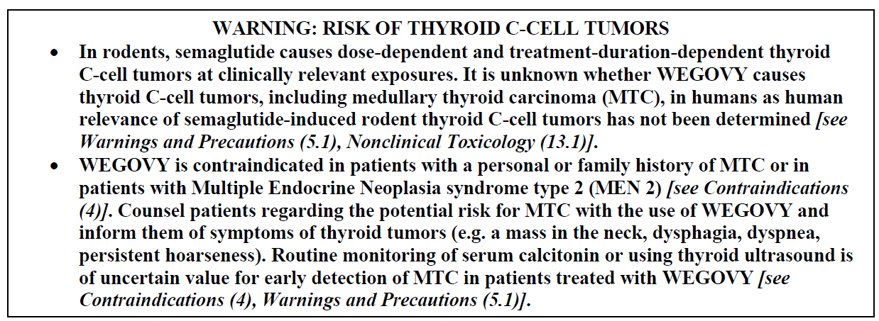
Box Warning
A copy of the current FDA label for Semaglutide 2.4mg injection can be obtained by typing in https://www.novo-pi.com/wegovy.pdf in
Your web browser or by scanning the QR code
Wegovy® [package insert]. Novo Nordisk Inc.

Slide 5
Indications and Usage
Section 1
Indication
WEGOVY injection is indicated in combination with a reduced calorie diet and increased physical activity:
To reduce the risk of major adverse cardiovascular (CV) events (CV death, non-fatal myocardial infarction, or non-fatal stroke) in adults with established CV disease and either obesity or overweight.
To reduce excess body weight and maintain weight reduction long term in:
  Adults and pediatric patients aged 12 years and older with obesity.
  Adults with overweight in the presence of at least one weight-related comorbid condition.
For the treatment of noncirrhotic metabolic dysfunction-associated steatohepatitis (MASH), formerly known as nonalcoholic steatohepatitis (NASH), with moderate to advanced liver fibrosis (consistent with stage F2-F3 fibrosis). This indication is approved under accelerated approval based on improvement of MASH and fibrosis [see Clinical Studies (14.4)]. Continued approval for this indication may be contingent upon the verification and description of clinical benefit in confirmatory trials.
WEGOVY tablets are indicated in combination with a reduced calorie diet and increased physical activity:
To reduce the risk of major adverse CV events (CV death, non-fatal myocardial infarction, or non-fatal stroke) in adults with established CV disease and either obesity or overweight.
To reduce excess body weight and maintain weight reduction long term in adults with obesity, or in adults with overweight in the presence of at least one weight-related comorbid condition.
A copy of the current FDA label for Semaglutide 2.4mg injection can be obtained by typing in https://www.novo-pi.com/wegovy.pdf in
Your web browser or by scanning the QR code
Abbreviations: F, fibrosis; MASH, metabolic dysfunction-associated steatohepatitis.
Wegovy® [package insert]. Novo Nordisk Inc.

Slide 6

Indications and Usage
Section 1
Limitations of use
Concomitant use of WEGOVY (semaglutide) tablets or WEGOVY (semaglutide) injection with other semaglutide-containing products or with any other GLP-1 receptor agonist is not recommended.
A copy of the current FDA label for Semaglutide 2.4mg injection can be obtained by typing in https://www.novo-pi.com/wegovy.pdf in
Your web browser or by scanning the QR code
Abbreviations: GLP-1, glucagon-like peptide-1.
Wegovy® [package insert]. Novo Nordisk Inc.

Slide 7
Contraindications
Section 4
Contraindications
WEGOVY is contraindicated in the following conditions:
A personal or family history of MTC or in patients with MEN 2 [see Warnings and Precautions (5.1)].
Known hypersensitivity to semaglutide or any of the excipients in WEGOVY® tablets or WEGOVY® injection [see Warnings and Precautions (5.7)].
A copy of the current FDA label for Semaglutide 2.4mg injection can be obtained by typing in https://www.novo-pi.com/wegovy.pdf in
Your web browser or by scanning the QR code
MEN 2, multiple endocrine neoplasia syndrome type 2; MTC, medullary thyroid carcinoma.
Wegovy® [package insert]. Novo Nordisk Inc.

Slide 8
Warnings and Precautions
Section 5.1
Risk of Thyroid C-Cell Tumors
In mice and rats, semaglutide caused a dose-dependent and treatment-duration-dependent increase in the incidence of thyroid C-cell tumors (adenomas and carcinomas) after lifetime exposure at clinically relevant plasma exposures [see Nonclinical Toxicology (13.1)]. It is unknown whether WEGOVY causes thyroid C-cell tumors, including MTC, in humans, as human relevance of semaglutide-induced rodent thyroid C-cell tumors has not been determined.
Cases of MTC in patients treated with liraglutide, another GLP-1 receptor agonist, have been reported in the postmarketing period; the data in these reports are insufficient to establish or exclude a causal relationship between MTC and GLP-1 receptor agonist use in humans.
A copy of the current FDA label for Semaglutide 2.4mg injection can be obtained by typing in https://www.novo-pi.com/wegovy.pdf in
Your web browser or by scanning the QR code
GLP-1, glucagon-like peptide-1; MTC, medullary thyroid carcinoma.
Wegovy® [package insert]. Novo Nordisk Inc.

Slide 9
Warnings and Precautions
Section 5.1
Risk of Thyroid C-Cell Tumors
WEGOVY is contraindicated in patients with a personal or family history of MTC or in patients with MEN 2. Counsel patients regarding the potential risk for MTC with the use of WEGOVY and inform them of symptoms of thyroid tumors (e.g., a mass in the neck, dysphagia, dyspnea, persistent hoarseness).
Routine monitoring of serum calcitonin or using thyroid ultrasound is of uncertain value for early detection of MTC in patients treated with WEGOVY. Such monitoring may increase the risk of unnecessary procedures, due to the low-test specificity for serum calcitonin and a high background incidence of thyroid disease. Significantly elevated serum calcitonin value may indicate MTC and patients with MTC usually have calcitonin values greater than 50 ng/L. If serum calcitonin is measured and found to be elevated, the patient should be further evaluated. Patients with thyroid nodules noted on physical examination or neck imaging should also be further evaluated.
A copy of the current FDA label for Semaglutide 2.4mg injection can be obtained by typing in https://www.novo-pi.com/wegovy.pdf in
Your web browser or by scanning the QR code
Abbreviations: MEN 2, Multiple Endocrine Neoplasia syndrome type 2; MTC , medullary thyroid carcinoma..
Wegovy® [package insert]. Novo Nordisk Inc.

Slide 10
Warnings and Precautions
Section 5.2
Acute Pancreatitis
Acute pancreatitis, including fatal and non-fatal hemorrhagic or necrotizing pancreatitis, has been observed in patients treated with GLP-1 receptor agonists, including WEGOVY [see Adverse Reactions (6)]. After initiation of WEGOVY, observe patients carefully for signs and symptoms of acute pancreatitis, which may include persistent or severe abdominal pain, (sometimes radiating to the back), and which may or may not be accompanied by nausea or vomiting. If acute pancreatitis is suspected, discontinue WEGOVY and initiate appropriate management.
A copy of the current FDA label for Semaglutide 2.4mg injection can be obtained by typing in https://www.novo-pi.com/wegovy.pdf in
Your web browser or by scanning the QR code
Abbreviations: GLP-1, glucagon-like peptide-1.
Wegovy® [package insert]. Novo Nordisk Inc.

Slide 11
Warnings and Precautions
Section 5.3
Acute Gallbladder Disease
Treatment with WEGOVY is associated with an increased occurrence of cholelithiasis and cholecystitis. The incidence of cholelithiasis and cholecystitis was higher in WEGOVY injection-treated pediatric patients aged 12 years and older than in WEGOVY injection-treated adults. In randomized clinical trials in adults for weight reduction, cholelithiasis was reported by 1.6% of WEGOVY injection-treated patients and 0.7% of placebo injection-treated patients. Cholecystitis was reported by 0.6% of WEGOVY injection-treated adult patients and 0.2% of placebo injection-treated patients. In a clinical trial in pediatric patients aged 12 years and older for weight reduction, cholelithiasis was reported by 3.8% of WEGOVY injection-treated patients and 0% placebo injection-treated patients. Cholecystitis was reported by 0.8% of WEGOVY injection-treated pediatric patients and 0% placebo injection-treated patients [see Adverse Reactions (6.1)].
Substantial or rapid weight loss can increase the risk of cholelithiasis; however, the incidence of acute gallbladder disease was greater in WEGOVY-treated patients than in placebo-treated patients, even after accounting for the degree of weight loss. If cholelithiasis is suspected, gallbladder studies and appropriate clinical follow-up are indicated.
A copy of the current FDA label for Semaglutide 2.4mg injection can be obtained by typing in https://www.novo-pi.com/wegovy.pdf in
Your web browser or by scanning the QR code
Wegovy® [package insert]. Novo Nordisk Inc.

Slide 12
Warnings and Precautions
Section 5.4
Hypoglycemia
WEGOVY lowers blood glucose and can cause hypoglycemia.
In a trial of WEGOVY injection in adult patients with type 2 diabetes and body mass index (BMI) greater than or equal to 27 kg/m² for weight reduction (Study 3), hypoglycemia (defined as a plasma glucose less than 54 mg/dL) was reported in more patients treated with WEGOVY versus placebo. One episode of severe hypoglycemia (requiring the assistance of another person) was reported in one WEGOVY-treated patient versus no placebo-treated patients [see Clinical Studies (14.2)].
In glycemic control clinical trials, the risk of hypoglycemia was increased when semaglutide injection or tablet was used concomitantly with insulin or an insulin secretagogue (e.g., sulfonylurea). Patients with diabetes mellitus taking WEGOVY in combination with insulin or an insulin secretagogue may have an increased risk of hypoglycemia, including severe hypoglycemia. The use of WEGOVY in patients with type 1 diabetes mellitus or in combination with insulin has not been evaluated.
Inform patients of the risk of hypoglycemia and educate them on the signs and symptoms of hypoglycemia. In patients with diabetes, monitor blood glucose prior to starting WEGOVY and during WEGOVY treatment. When initiating WEGOVY, consider reducing the dose of concomitantly administered insulin or insulin secretagogue (such as sulfonylureas) to reduce the risk of hypoglycemia [see Drug Interactions (7.1)].
A copy of the current FDA label for Semaglutide 2.4mg injection can be obtained by typing in https://www.novo-pi.com/wegovy.pdf in
Your web browser or by scanning the QR code
Abbreviations: BMI, body mass index.
Wegovy® [package insert]. Novo Nordisk Inc.

Slide 13
Warnings and Precautions
Section 5.5 and 5.6
Acute Kidney Injury Due to Volume Depletion
There have been postmarketing reports of acute kidney injury, in some cases required hemodialysis, in patients treated with semaglutide [see Adverse Reactions (6)]. The majority of the reported events occurred in patients who experienced gastrointestinal reactions leading to dehydration such as nausea, vomiting, or diarrhea [see Adverse Reactions (6)].
Monitor renal function in patients reporting adverse reactions to WEGOVY that could lead to volume depletion, especially during dosage initiation and escalation of WEGOVY.
Severe Gastrointestinal Adverse Reactions
Use of WEGOVY has been associated with gastrointestinal adverse reactions, sometimes severe [see Adverse Reactions (6.1)]. In clinical trials for adults for weight reduction, severe gastrointestinal adverse reactions were reported more frequently among patients receiving WEGOVY than placebo. Severe gastrointestinal adverse reactions were reported in 4.1% and 0.9% of WEGOVY-injection and placebo-treated patients, respectively,
and in 2% of WEGOVY tablet-treated and 0% of placebo-treated patients, respectively. Severe gastrointestinal adverse reactions have also been reported postmarketing with GLP-1 receptor agonists.
WEGOVY is not recommended in patients with severe gastroparesis.
A copy of the current FDA label for Semaglutide 2.4mg injection can be obtained by typing in https://www.novo-pi.com/wegovy.pdf in
Your web browser or by scanning the QR code
Wegovy® [package insert]. Novo Nordisk Inc.
Notes:
Unless indicated, the incidence of the adverse reactions in MASH patients was similar to other approved indications.

Slide 14
Warnings and Precautions
Section 5.7
Hypersensitivity Reactions
Serious hypersensitivity reactions (e.g., anaphylaxis, angioedema) have been reported with WEGOVY. If hypersensitivity reactions occur, discontinue use of WEGOVY, treat promptly per standard of care, and monitor until signs and symptoms resolve. WEGOVY is contraindicated in patients with a prior serious hypersensitivity reaction to semaglutide or to any of the excipients in WEGOVY [see Adverse Reactions (6.2)].
Anaphylaxis and angioedema have been reported with other GLP-1 receptor agonists. Use caution in a patient with a history of anaphylaxis or angioedema with another GLP-1 receptor agonist because it is unknown whether such patients will be predisposed to these reactions with WEGOVY.
A copy of the current FDA label for Semaglutide 2.4mg injection can be obtained by typing in https://www.novo-pi.com/wegovy.pdf in
Your web browser or by scanning the QR code
Abbreviations: BMI, body mass index; GLP-1, glucagon-like peptide-1.
Wegovy® [package insert]. Novo Nordisk Inc.

Slide 15
Warnings and Precautions
Section 5.8
Diabetic Retinopathy Complications in Patients with Type 2 Diabetes
In a 2-year trial with semaglutide 0.5 mg and 1 mg once-weekly injection in adult patients with type 2 diabetes and high CV risk, diabetic retinopathy complications (which was a 4-component adjudicated endpoint) occurred in patients treated with semaglutide injection (3%) compared to placebo (1.8%). The absolute risk increase for diabetic retinopathy complications was larger among patients with a history of diabetic retinopathy at baseline (semaglutide injection 8.2%, placebo 5.2%) than among patients without a known history of diabetic retinopathy (semaglutide injection 0.7%, placebo 0.4%).
In a trial of adult patients with type 2 diabetes and BMI greater than or equal to 27 kg/m² for weight reduction (Study 3), diabetic retinopathy was reported by 4% of WEGOVY injection-treated patients and 2.7% placebo-treated patients [see Clinical Studies (14.2)].
In a glycemic control trial evaluating a dose comparable to the 9 mg dose and the 25 mg semaglutide tablet dose in patients with type 2 diabetes, a similar proportion of patients in each dose group reported diabetic retinopathy related adverse reactions during the trial; 1.3% and 1.9% of patients in the 9 mg and 25 mg semaglutide group, respectively, reported moderate-severe non-proliferative diabetic retinopathy events, and 0% and 0.4% reported proliferative retinopathy events, respectively.
Rapid improvement in glucose control has been associated with a temporary worsening of diabetic retinopathy. The effect of long-term glycemic control with semaglutide on diabetic retinopathy complications has not been studied. Patients with a history of diabetic retinopathy should be monitored for progression of diabetic retinopathy.
A copy of the current FDA label for Semaglutide 2.4mg injection can be obtained by typing in https://www.novo-pi.com/wegovy.pdf in
Your web browser or by scanning the QR code
Abbreviations: BMI, body mass index; CV, cardiovascular.
Wegovy® [package insert]. Novo Nordisk Inc.

Slide 16
Warnings and Precautions
Section 5.9
Heart Rate Increase
Treatment with WEGOVY was associated with increases in resting heart rate. Mean increases in resting heart rate of 1 to 4 beats per minute (bpm) were observed in WEGOVY injection-treated adult patients compared to placebo in clinical trials for weight reduction. More adult patients treated with WEGOVY injection compared with placebo had maximum changes from baseline at any visit of 10 to 19 bpm (41% versus 34%, respectively) and 20 bpm or more (26% versus 16%, respectively). In a clinical trial in pediatric patients aged 12 years and older with normal baseline heart rate, more patients treated with WEGOVY injection compared to placebo had maximum changes in heart rate of 20 bpm or more (54% versus 39%) [see Adverse Reactions (6.1)]. Findings were similar in a trial with the WEGOVY tablets.
Monitor heart rate at regular intervals consistent with usual clinical practice. Instruct patients to inform their healthcare providers of palpitations or feelings of a racing heartbeat while at rest during WEGOVY treatment. If patients experience a sustained increase in resting heart rate, discontinue WEGOVY.
A copy of the current FDA label for Semaglutide 2.4mg injection can be obtained by typing in https://www.novo-pi.com/wegovy.pdf in
Your web browser or by scanning the QR code
Bpm, beats per minute; Wegovy® [package insert]. Novo Nordisk Inc.

Slide 17
Warnings and Precautions
Section 5.10
Pulmonary Aspiration During General Anesthesia or Deep Sedation
WEGOVY delays gastric emptying [see Clinical Pharmacology (12.2)]. There have been rare postmarketing reports of pulmonary aspiration in patients receiving GLP-1 receptor agonists undergoing elective surgeries or procedures requiring general anesthesia or deep sedation who had residual gastric contents despite reported adherence to preoperative fasting recommendations.
Available data are insufficient to inform recommendations to mitigate the risk of pulmonary aspiration during general anesthesia or deep sedation in patients taking WEGOVY, including whether modifying preoperative fasting recommendations or temporarily discontinuing WEGOVY could reduce the incidence of retained gastric contents. Instruct patients to inform healthcare providers prior to any planned surgeries or procedures if they are taking WEGOVY.
A copy of the current FDA label for Semaglutide 2.4mg injection can be obtained by typing in https://www.novo-pi.com/wegovy.pdf in
Your web browser or by scanning the QR code
Abbreviations: BMI, body mass index; GLP-1, glucagon-like peptide-1.
Wegovy® [package insert]. Novo Nordisk Inc.

Slide 18
Novo Nordisk provides the following disclosures as to the authors related to the period of writing, editing, and/or contributing to the source publication
Javed Butler- Consultant to Novo Nordisk.
Sanjiv J. Shah- Received consulting fees from Novo Nordisk.
Mark C. Petrie- Consultant to Novo Nordisk. Received research funding from Novo Nordisk.
Barry A. Borlaug- Consultant to Novo Nordisk. Received research funding from Novo Nordisk.
Melanie J. Davies- Consultant to Novo Nordisk. Advisory board and speaker of Novo Nordisk. Received grants from Novo Nordisk.
Darlene W. Kitzman- Consultant honoraria from Novo Nordisk. Received grant funding from Novo Nordisk.
Subodh Verma- Received consulting and speaker fees from Nove Nordisk.
Walter Abhayaratana- Received honoraria and consulting fees from Novo Nordisk.
Fozia Z Ahmed- Received honoraria and consulting fees from Novo Nordisk.
Vijay Chopra- Received speaker fees from Novo Nordisk.
Justin A Ezekowitz- Received research support and consulting fees from Novo Nordisk.
Butler, Javed et al. “Semaglutide versus placebo in people with obesity-related heart failure with preserved ejection fraction: a pooled analysis of the STEP-HFpEF and STEP-HFpEF DM randomised trials.” Lancet (London, England) vol. 403,10437 (2024): 1635-1648. doi:10.1016/S0140-6736(24)00469-0
Notes:
Semaglutide versus placebo in people with obesity-related heart failure with preserved ejection fraction: a pooled analysis of the STEP-HFpEF and STEP-HFpEF DM randomised trials

Slide 19
Novo Nordisk provides the following disclosures as to the authors related to the period of writing, editing, and/or contributing to the source publication
Hiroshi Ito- Received honoraria and consulting fees from Novo Nordisk.
Małgorzata Lelonek- Received honoraria and consulting fees from Novo Nordisk.
Vojtěch Melenovský- Received consulting fees from Novo Nordisk.
Bela Merkely- Received institutional payments that included Novo Nordisk collaborations.
Julio Núñez- Received honoraria and consulting fees from Novo Nordisk.
Eduardo Perna- Honoraria from Novo Nordisk.
Morten Schou- Received speaker fees from Novo Nordisk.
Michele Senni- Received honoraria and consulting fees from Novo Nordisk.
Kavita Sharma- Advisory and consulting fees from Novo Nordisk.
Peter van der Meer- Institutional payments for consultancy/grants including Novo Nordisk
Dirk Von Lewinski- Received honoraria and consulting fees from Novo Nordisk.
Dennis Wolf- Received consultancy fees from Novo Nordisk.
Mikhail N Kosiborod- Received consultancy/advisory fees, grants, and honoraria from Novo Nordisk.
Butler, Javed et al. “Semaglutide versus placebo in people with obesity-related heart failure with preserved ejection fraction: a pooled analysis of the STEP-HFpEF and STEP-HFpEF DM randomised trials.” Lancet (London, England) vol. 403,10437 (2024): 1635-1648. doi:10.1016/S0140-6736(24)00469-0
Notes:
Semaglutide versus placebo in people with obesity-related heart failure with preserved ejection fraction: a pooled analysis of the STEP-HFpEF and STEP-HFpEF DM randomised trials

Slide 20
Novo Nordisk provides the following disclosures as to the authors related to the period of writing, editing, and/or contributing to the source publication
Cecilia Rönnbäck- Employee of Novo Nordisk.
Anne Domdey- Employee and shareholder of Novo Nordisk.
Søren Rasmussen- Employee of Novo Nordisk.
Ambarish Pandey- Consultant/advisor roles include Novo Nordisk.
Subodh Verma- Consulting/speaking honoraria include Novo Nordisk.
Barry A. Borlaug- Consultant and recipient of research funding from Novo Nordisk.
Melanie J. Davies- Consultant, advisory board member, speaker, and grant recipient from Novo Nordisk.
Dalane W. Kitzman- Consulting honoraria and research funding from Novo Nordisk.
Sanjiv J. Shah- Consulting fees from Novo Nordisk.
Mark C. Petrie- Consultant and research funding from Novo Nordisk.
Mikhail N. Kosiborod- Consultant/advisory board member; received honoraria from Novo Nordisk.
Pandey, Ambarish et al. “Effects of semaglutide in obesity-related heart failure with preserved ejection fraction across the age spectrum: Findings from the STEP-HFpEF programme.” European journal of heart failure vol. 27,11 (2025): 2537-2543. doi:10.1002/ejhf.70049
Notes:
Effects of semaglutide in obesity‐related heart failure with preserved ejection fraction across the age spectrum: Findings from the STEP‐HFpEF programme

